Slide 1

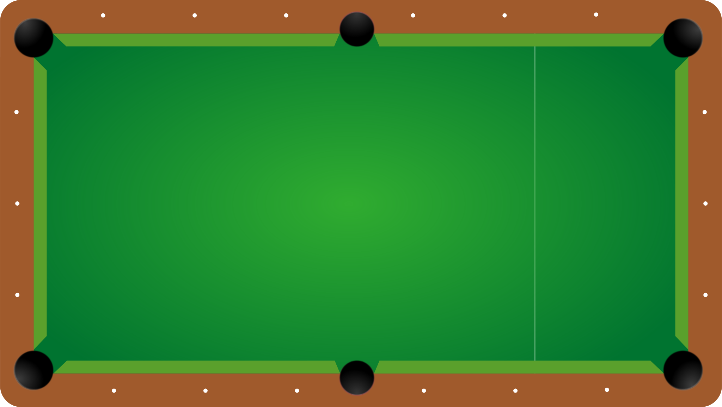
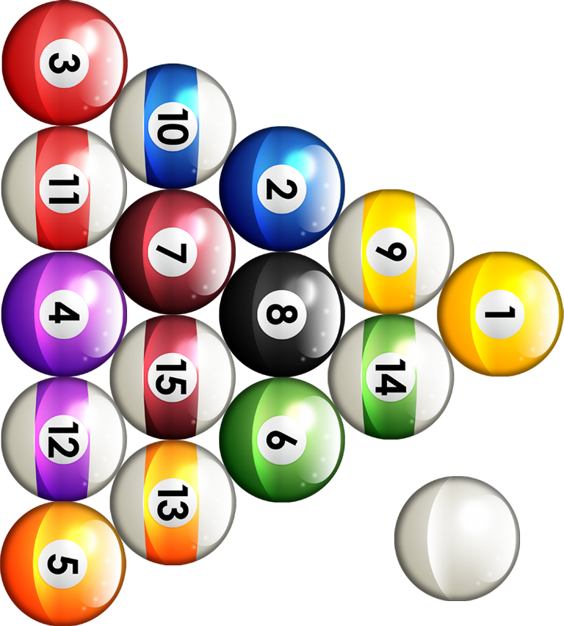
Scoremaster
Cristina Bindschatel
Luke Jeries
Will Rieske
Taylor Shephard
Dan Wiseman
Team Indecisive Productivity
C

Slide 2
Overview
Scope
Technologies Used
Use Case Diagram
Text Use Case
Test Case
Personas
Architecture
Sequence Diagram
Class Diagram
Questions?
C

Slide 3
Purpose of the System
Provide a convenient, alternative way to paper scoresheets for 8-ball billiards.
Show how easily the system can be replicated across different apps for scoring different games. (Golf, Bowling)
Scope of the System
Scorekeeping for 8-ball
Single-player, group-play
Easy-to-use scoring experience
Players can score games, view a match in progress, track statistics and game history, and group maintenance.
What it Doesn’t Do
Facilitate matchmaking within a group (two groups must play against each other)
Allow concurrent editing
No immediate support for any scoring games besides 8-ball
Notes:
Too much text? I animated it so that it is one section at a time.

Slide 4

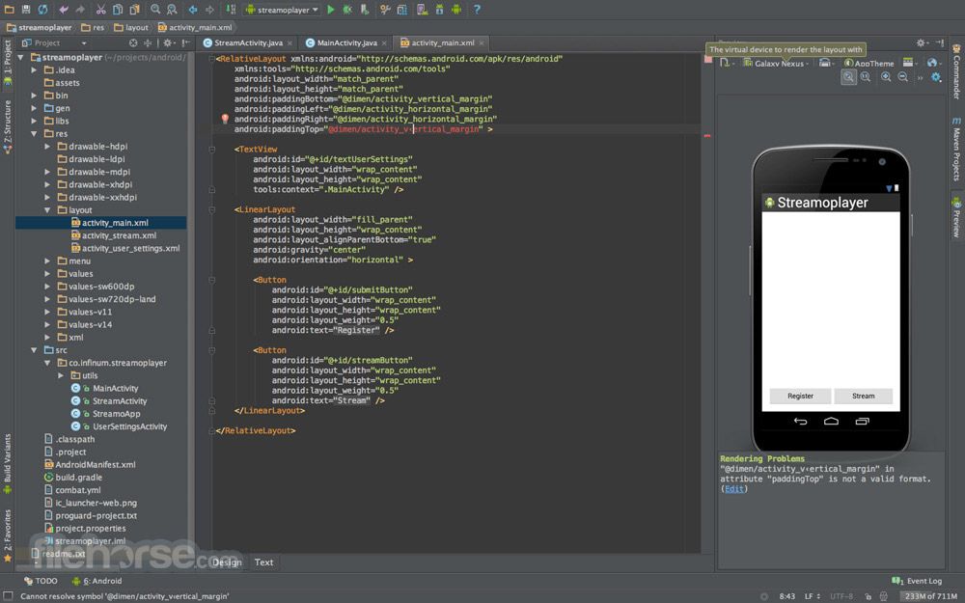

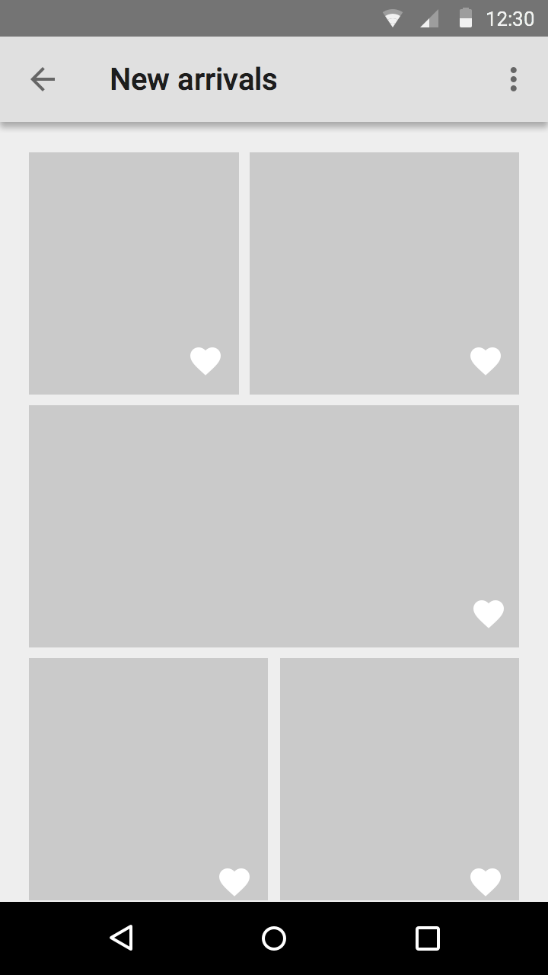
Technologies Used
Technologies used are…
Google Drive
Android Studio
FireBase
Draw.io/Umlet
Android is the best!
Firebase is not!
C

Slide 5
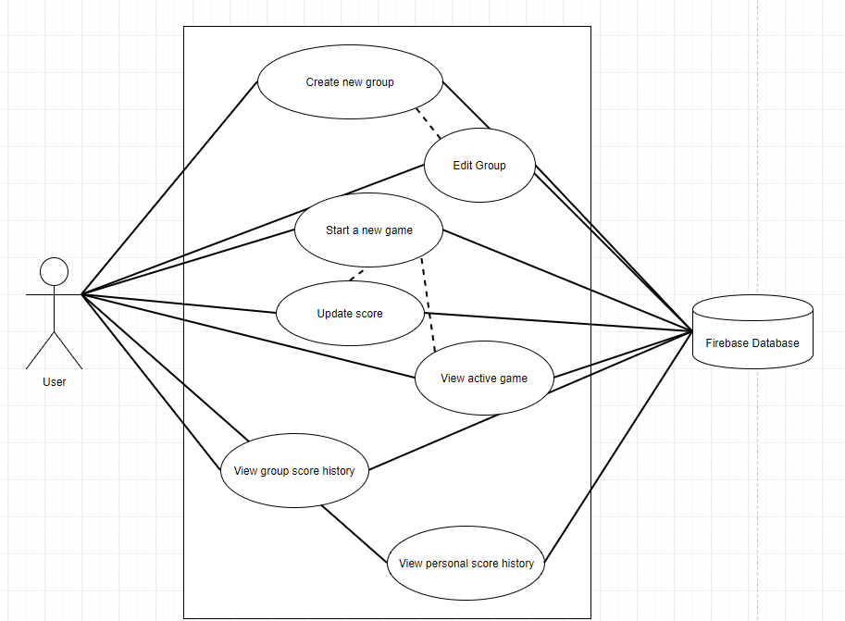
Use Case Diagram
L

Slide 6
Text Use Case
Use Case ID: SM801
Scenario: Start a new Group Game
Actor: User
Pre-Conditions:
1. User is logged in
2. User is part of a group with more than 1 member
Description:
User opens the app
User selects the “groups” option on main menu
System switches to Groups screen
User selects the group they wish to play with from drop down menu.
System fetches the group player list
User selects the players for the game and confirms
System logs a new game instance
System loads game scoring screen
Post Conditions:
A new game entry has been stored for the group.
Group statistic for games played increases by 1
Alternate Courses of Action:
In step D.5, if exactly 2 players are not selected, the system shall prompt the user to enter the correct number of players.
Exceptions:
System fails to retrieve group player list
L

Slide 7
“No Players” Test Case
Test Case ID: TSM801-01
Test Priority (Low/Medium/High): Med
Module Name: Groups
Test Title: GroupGameNoPlayers
Testing Tool:
Description: Attempt to start a group game with no players selected
Steps | Test Step | Test Data | Expected Result | Actual Result
1 | User opens Groups page | NA | Group page opens
2 | User selects group “Friday League” | NA | Player list for “Friday League” is displayed
3 | User selects Start Game with no players selected | NA | Error message displayed
L

Slide 8
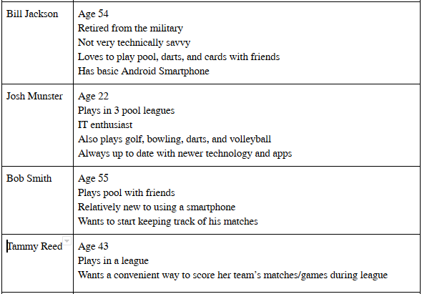
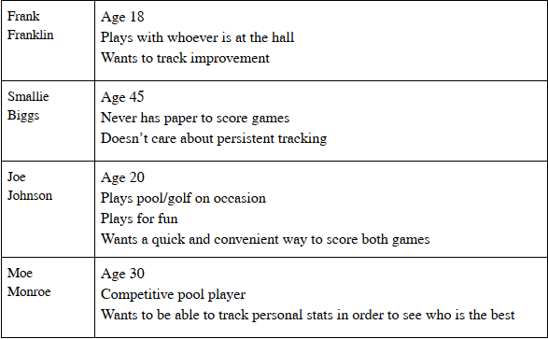
Personas
T

Slide 9
Prototype Storyboard
Walkthrough
T

Slide 10
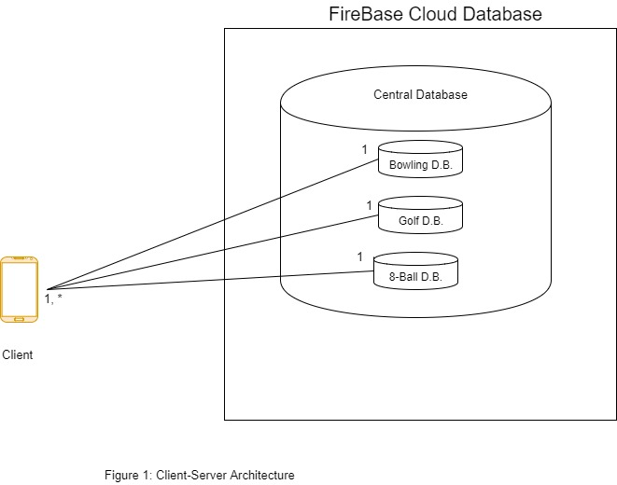
Architecture
D

Slide 11
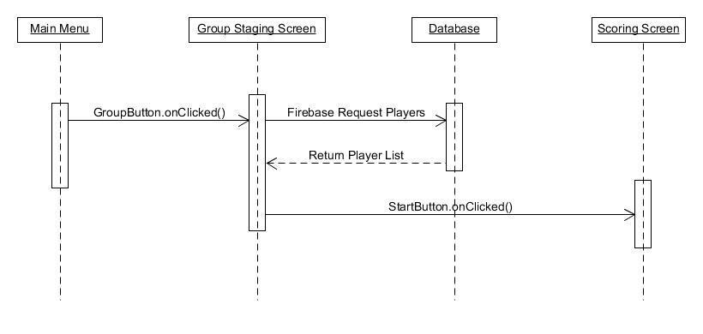
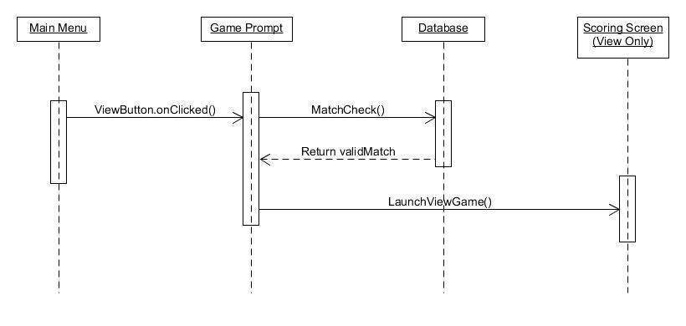
Sequence Diagram
Sequence Diagram for “Start a new Group Game”
Sequence Diagram for “View Active Game”
D

Slide 12
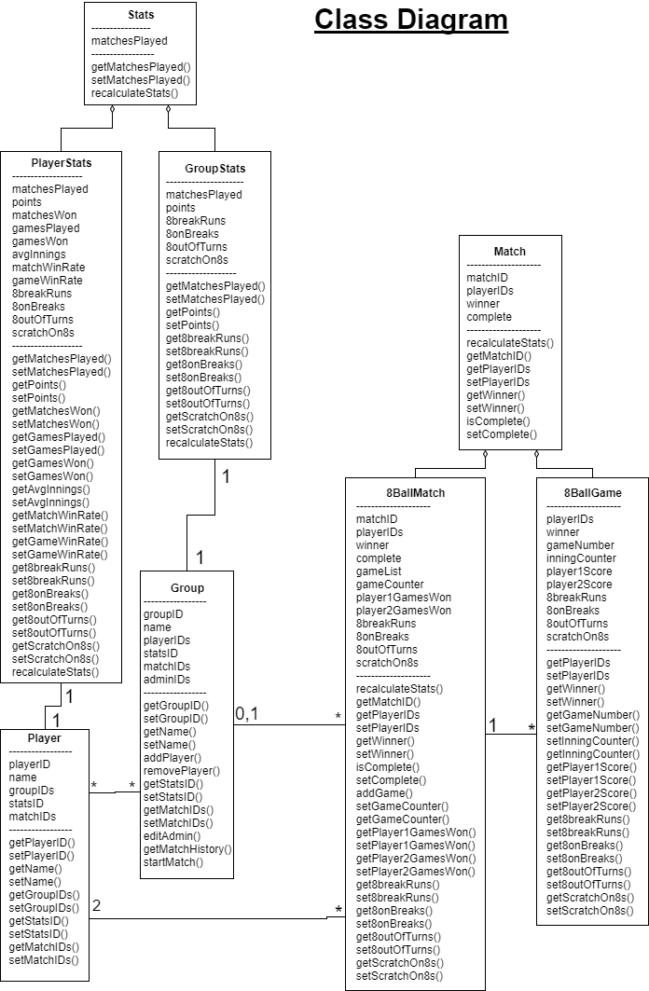
Class Diagram
W

Slide 13
Questions?
W

